Slide 1
Group 14: Euchre
Reid Richardson
Jordan Olivier
Daniel Ariza
Emmanuel Lopez

Slide 2
An Introduction to Euchre
Euchre was originally created by German settlers in Pennsylvania. It is believed the game was derived from an 18th century game known as “Juckerspiel”. The game is played by four people divided into two teams. A trump suit is selected and players play cards to match the trump suit.

Slide 3
Basis for Implementation
The game we designed was based on the Functional Requirements given to us by Group 4. All decisions made on software implementation were determined by the requirements outlined in the document, and nothing else.

Slide 4
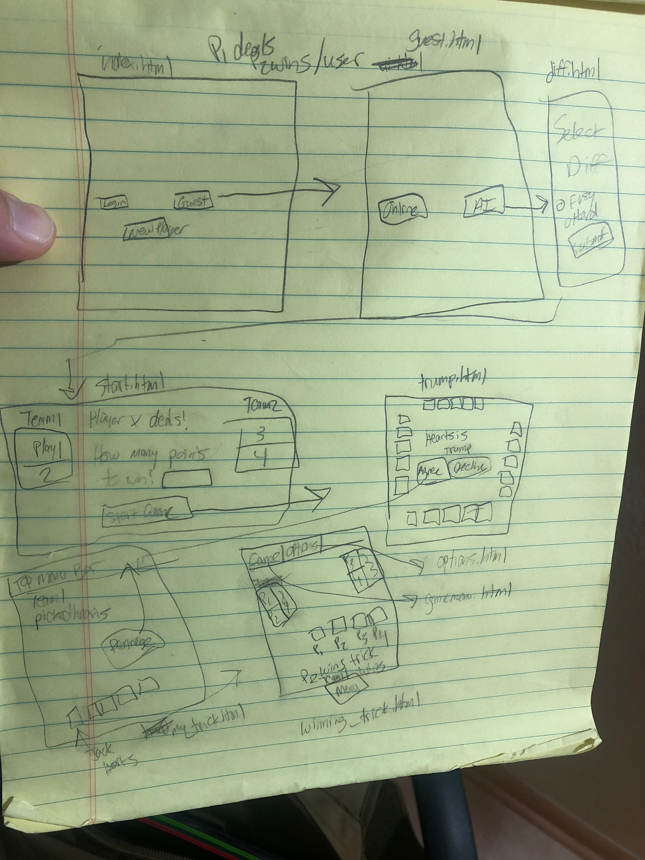
Initial Prototype
Notes:
Met to create plan of attack
Decided to use onedrive to store everything
Discussed the expectations in the rubric
Decided to create using html
Easy to implement a backend using PHP later on

Slide 5
Interface Requirements
As the user opens the software, a menu displays on the screen. Multiple menu options are available for the user, such as “new player”, “log in”, or “guest.” The user then selects whether to play online or play against the computer. If the user selects online gameplay, the system stores this information and selects the other three players from the web at random. If the user wishes to compete against the AI, the application proceeds to ask the user the level of difficulty he or she wishes to battle and sets the user to play against three computer generated players.
Notes:
First paragraph for the interface requirements given to us
Our goal was to base what we implemented entirely on the requirements presented
The new few slides will show the implementation of these first few menus outlined.

Slide 6

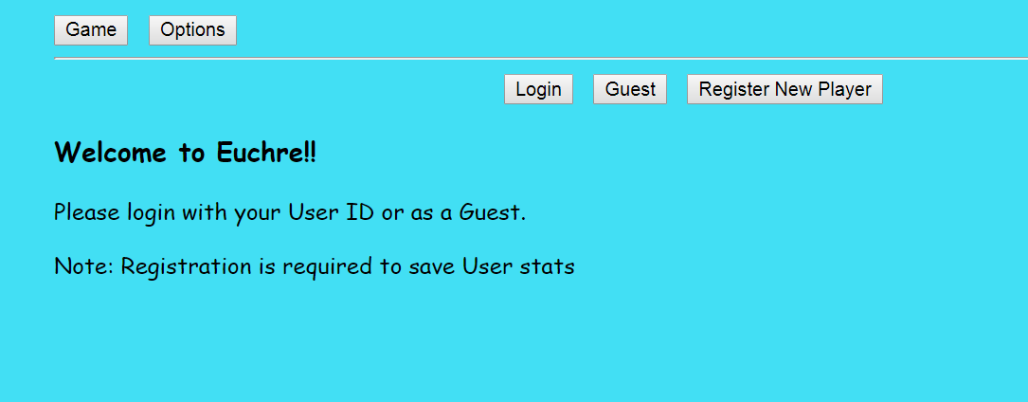
Opening the app
No information was given about what occurs if the user selects new player or login.
As a result, we focused on the guest feature, as no actual back end online play or player tracking was implemented.

Slide 7
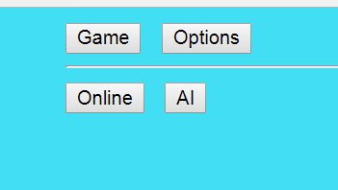
Playing as a Guest

Slide 8
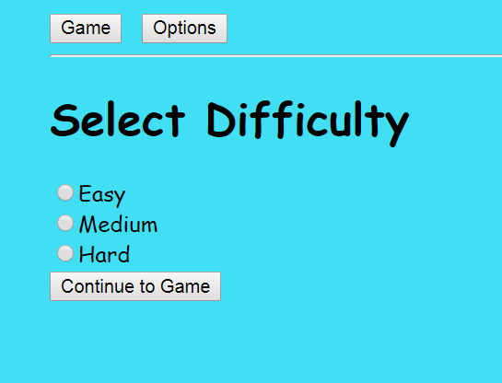
Selecting a Difficulty
We used standard difficulty features of Easy, Medium and Hard. No specifics were given in the requirements about how many difficulty options to choose from. We decided to use radio buttons as the user would only be allowed to select one difficulty.

Slide 9
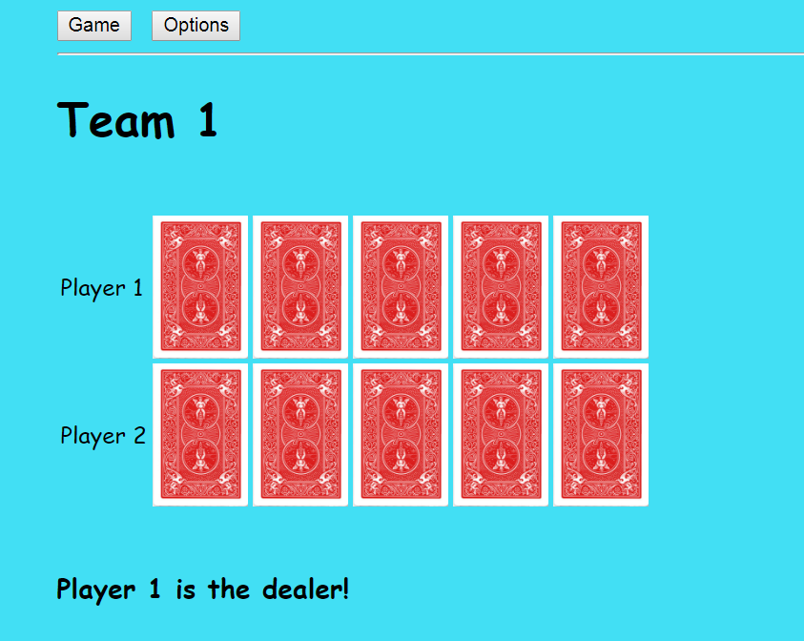
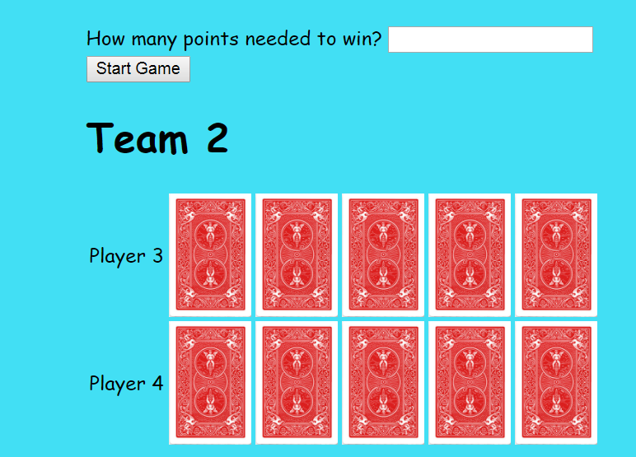
The Ready to Play Queue
Everyone’s cards have been dealt and the dealer is asked how many points are needed to win the game.
Notes:
After selecting a difficult, the system shuffles and deals cards face down.
The dealer is asked to select a point total between 10 and 50 needed to win
For the simulation, the game will be played to 50 points

Slide 10
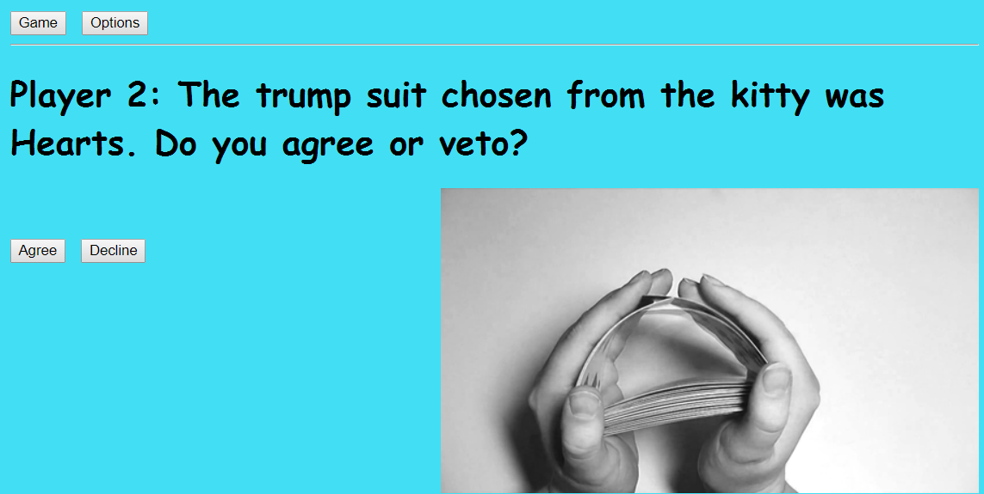
Trump Suit Selection
The user is asked if they accept the trump suit. For sake of simplicity, during the simulation, the trump suit will be agreed upon.
Notes:
After the dealer selects the amount of points needed to win, the next player is asked to accept a randomly chosen trump suit.
The user can agree or decline
If declined, next user would pick the trump suit which would be randomly generated
In this simulation, player 2 agrees with the trump suit being heats

Slide 11
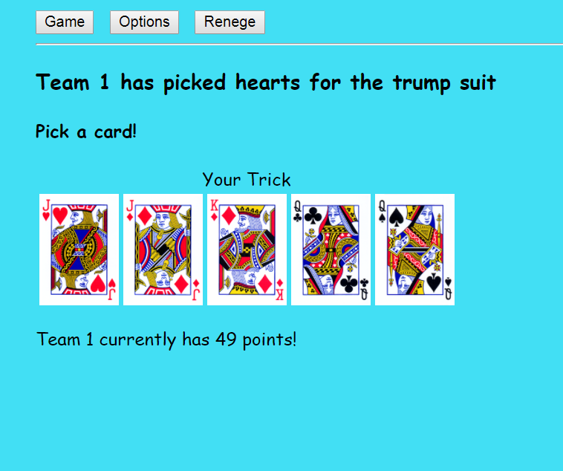
The User’s Trick
“The monitor displays the point of view of the user, showing the user holding the cards. “
The user’s hand is shown here
Notes:
After the trump suit is chosen and the game starts, each player is shown their hand of 5 cards.
We chose the standard Bicycle cards print as it was easily recognizable.
The hand is sorted by suit.
The trump suit is shown at the top and each player is instructed to put a card into the trick.
We are playing as player 2 and will choose the Jack of Hearts.
Team 1 (comprised of players 1 & 2) are one point away from winning.

Slide 12
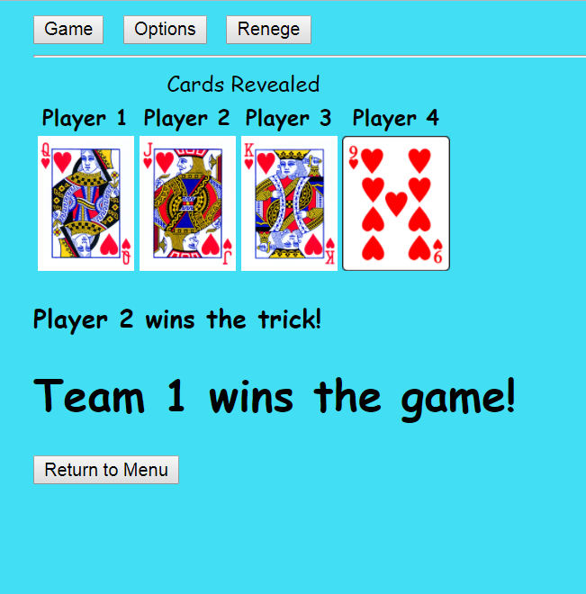
Cards Displayed and Winner Declared
There were no interface requirements given for the players revealing their cards. As a result, this page was implemented based on what we believed it would look like.
Notes:
Once the players have chosen a card from their hand, all of the selected cards are revealed to the players.
Each card is labeled by the player who chose it.
The player with the highest card wins the trick, which in this case is the Jack of Hearts played by us.
The system then says which player wins the trick and if the max amount of points is reached, which team won the entire game.

Slide 13

Menu Bar
HTI principles
“This button is displayed inside the top menu bar. The menu bar additionally contains the options “Game” and “Options.” “
Game and Options are not clickable until a game has begun. Renege does not appear until the game is in play
Notes:
Here we have the menu bar which is located at the top of each page.
It always contains the buttons "Game" and "Options", but they aren't clickable until a game has begun, which is when the amount of points needed to win is selected.
The renege button appears once the game has started, which is when everyone is shown their hands.

Slide 14
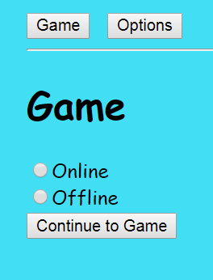
Game Page
“The Game menu allows the user to easily change from competing against players online and competing against the AI. “
Notes:
This is the "Game" menu, which allows the user to easily switch between online and AI.
This brings up the question of how this function would work. If you were online and clicked offline, would it just kick you out of the game and replace you with an AI player? Would it cancel the game for everyone?
The name "Game" could also be a bit confusing to players because what would a menu titled game have in it?

Slide 15
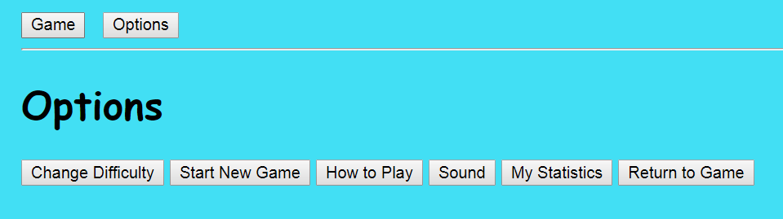
Options
The Options menu includes “game difficulty” settings (when competing against AI), “start new game,” “how to play,” “sound,” and a “my statistics” menu.
Notes:
These labels were specifically requested in the FRD we received from 4. Back end would show previous game scores under the statistics button. The sound button would change the sound effects that play when cards are played. How to play may link to the wiki page for the game.

Slide 16
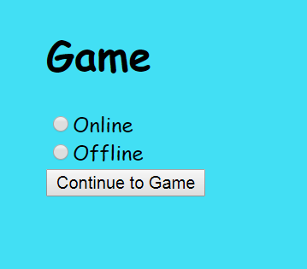
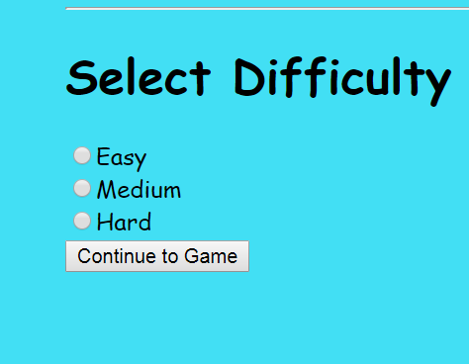
HTI Guidelines/Principles Implemented
Ensured pages printed properly with correct images and hyperlinks
Use of radio buttons for binary choices
Notes:
Whenever we had the opportunity to make the user choice a binary choice we did that. It a very effective way to reduce the rate of human error. Its specifically described by the National Cancer Institute's guidelines about Navigating interfaces.

Slide 17
HTI Guidelines (cont.) - Display
Display remains consistent throughout
Pages go from Left to Right and from Top to Bottom
Used no more than 4 font sizes and no more than 3 font styles
No more than four colors used in the display
Notes:
As described by Smith and Mosier in 1986 when they offered five high-level goals for organizing a display.
Fonts sizes, styles and the color of the pages were also designed with the general interface guidelines about getting the User's attention.

Slide 18
HTI Principle- Consistency through Grammar
Use of common words that are generally associated with card games
"Trick", "Kitty", "Trump", "Suit"
Common words used for game difficulty selection - ("Easy, Medium, or Hard")
Catering to Universal usability/ Minimal Memory Load
Inconsistent wording leads to confusion and user errors
Notes:
The use of common words usually associated to card games and for general game options adhere to a few of the 8 golden rules of interface design. We tried to strive for consistency and cater to universal usability. And we believe that consistency leads directly to minimizing the memory load

